Slide 1
Annual General Meeting of Shareholders (AGM)
Agustus 26th, 2021

Slide 2
Meeting Time & Venue
PT. Indah Kiat Pulp & Paper Tbk. (The ”Company”) will hold the AGM on :
Day/Date : Thursday, Agustus 26th, 2021
Waktu : 09.30 – 10.30 Western Indonesia Standard Time (WIB)
Tempat : Hotel Grand Hyatt
Jl. MH.Thamrin No.Kav 28-30
Jakarta Pusat

Slide 3
Meeting Agenda
AGM
To submit the annual report of the Company by the Board of Directors and to approve of the Company's Consolidated Financial Statements for the financial year ending on December 31st, 2020 and submit the Supervisory Report by the Board of Commissioner for the financial year ending on December 31st, 2020 and grant full acquittal and discharged (acquit et de charge) to the Board of Directors and Commissioner of the Company over any management and supervision action conducted by them during the financial year ending December 31st, 2020.
To approve the Company's profits appropriation for the financial year ended of December 31st, 2020.
To appoint the Independent Public Accountant as registered at OJK in order to audit the Company's financial report for the year 2021 and authorise the Boards of Directors to determine the fees of the appointed Independent Public Accountant.
To determine the salary, honorarium, and/or allowances for the Board of Commissioners and the Directors of the Company for financial year 2021.
Approving changes in the composition of the members of the Board of Commissioners and the Directors.
Report on the Realisation of the Use of Proceeds of the Company’s Bond Public Offering.

Slide 4
Meeting Agenda Explanation
Notes to the Meeting Agenda for AGM as Follows :
Agenda 1 to 5 which among others are the agenda of the Company`s AGM in accordance with the Articles of Association of the Company. One and the other in accordance with the provision (s) in the Company`s Articles of Association,POJK, and Company Law Number 40 Year 2007.
Agenda 6 the obligation submit a report in accordance with POJK Number 30/POJK.04/2015 concerning realization report on the use fund from Public Offering.
The Company’s 2020 Annual Report including Consolidated Financial Statements of the Company and Its Subsidiaries for the Year Ended 31 December 2020 is available on the Company’s website: https://asiapulppaper.com/en/investors.

Slide 5
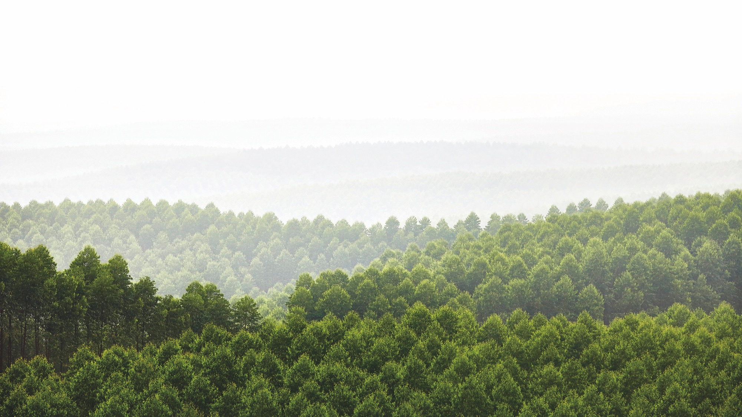
APP Mills - Environmental Performance
Thank You

